Slide 1
SWE2301: Introduction to software engineering
Lecture 02: Software Process Models
Venue: CIT Theater
Time: 10-1pm
Presented by M. I. Mukhtar

Slide 2
Lecture Outline
Software process models
Process activities
Coping with change

Slide 3
The Software Process
A structured set of activities required to develop a software system.
Many different software processes but all involve:
Specification – defining what the system should do;
Design and implementation – defining the organization of the system and implementing the system;
Validation – checking that it does what the customer wants;
Evolution – changing the system in response to changing customer needs.
A software process model is an abstract representation of a process. It presents a description of a process from some particular perspective.

Slide 4
Software Process Description
Process description involve discussing the activities in these processes such as specifying a data model, designing a user interface, etc. and the ordering of these activities.
Process descriptions may also include:
Products, which are the outcomes of a process activity;
Roles, which reflect the responsibilities of the people involved in the process;

Slide 5
Plan-driven and Agile Processes
Plan-driven processes are processes where all of the process activities are planned in advance and progress is measured against this plan.
In agile processes, planning is incremental and it is easier to change the process to reflect changing customer requirements.
In practice, most practical processes include elements of both plan-driven and agile approaches.

Slide 6
Software Process Model
A software process model is a diagrammatic representation of a software process.
A software process model is often called a software development life cycle (SDLC).
There are many SDLCs such as Waterfall Model, Iterative Enhancement Model, Spiral Model, Rational Unified Process model, V and W model Prototyping Model.
The most used are explained in details in the next slides..

Slide 7
Software Process Model
The waterfall model
Plan-driven model. Separate and distinct phases of specification and development.
Incremental development
Specification, development and validation are interleaved. May be plan-driven or agile.
Reuse-oriented software engineering
The system is assembled from existing components. May be plan-driven or agile.
Software Prototyping
A prototype is an initial version of a system used to demonstrate concepts and try out design options.
In practice, most large systems are developed using a process that incorporates elements from all of these models.

Slide 8
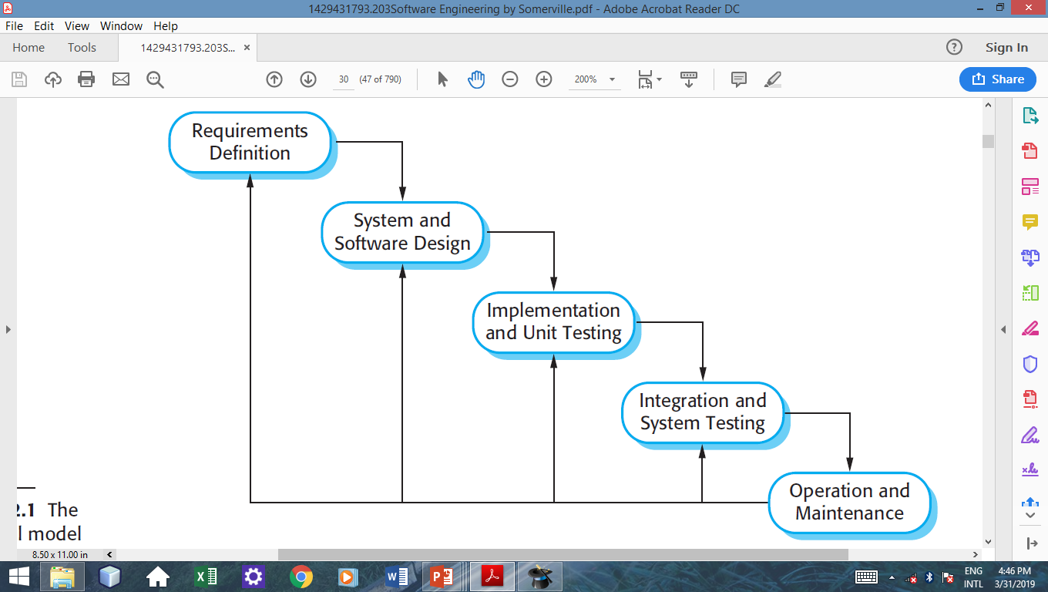
The Waterfall Model

Slide 9
The Waterfall Model..
Plan-driven model i.e. activities are planned and schedule before starting projects.
Process activities such as specification and design are represented as separate process phases.
mostly used for large systems engineering projects where a system is developed at several sites.

Slide 10
Waterfall Model Problems
Difficult to respond to changing customer requirements because of stages partitioning
Produces excessive documentation and keeping it updated as the project progresses is time-consuming.
Notes:
only appropriate when the requirements are well-understood and changes will be fairly limited during the design process.

Slide 11
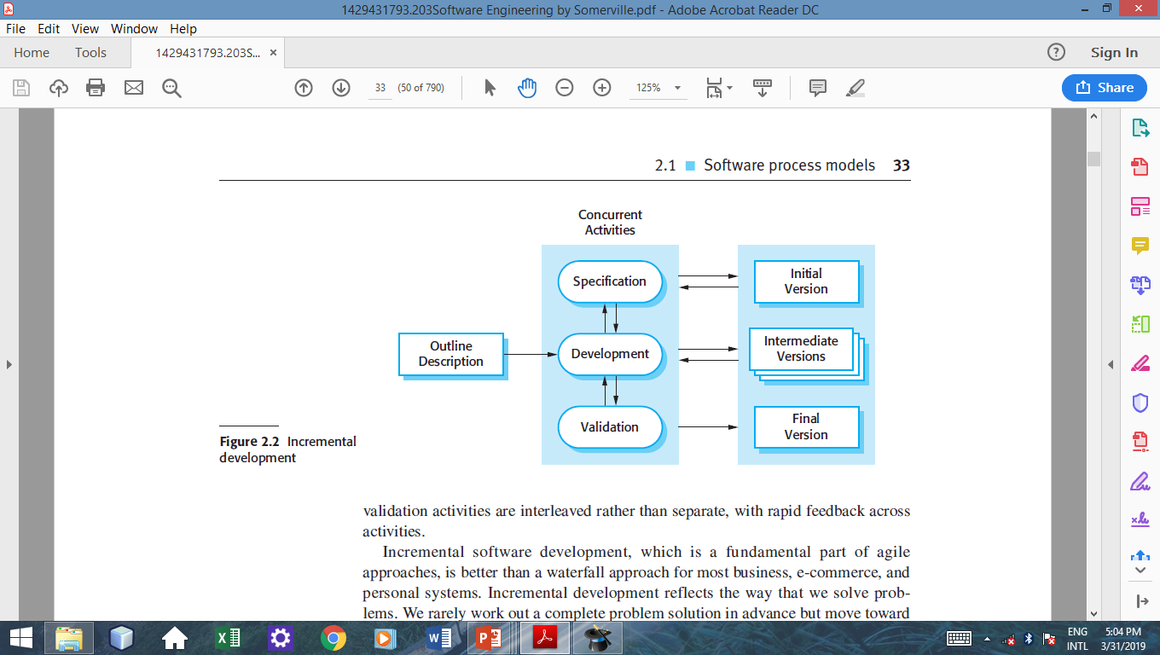
Incremental Development

Slide 12
Incremental Development
Uses agile development processes i.e. developing an software through several versions.
Process activities such as specification and design are interleaved rather than separate, with rapid feedback across activities.
Cheaper and easier to make changes in the software if it is developed incrementally.
Examples of incremental development models are Iterative Enhancement & Rapid application Development (RAD)

Slide 13
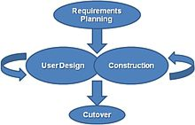
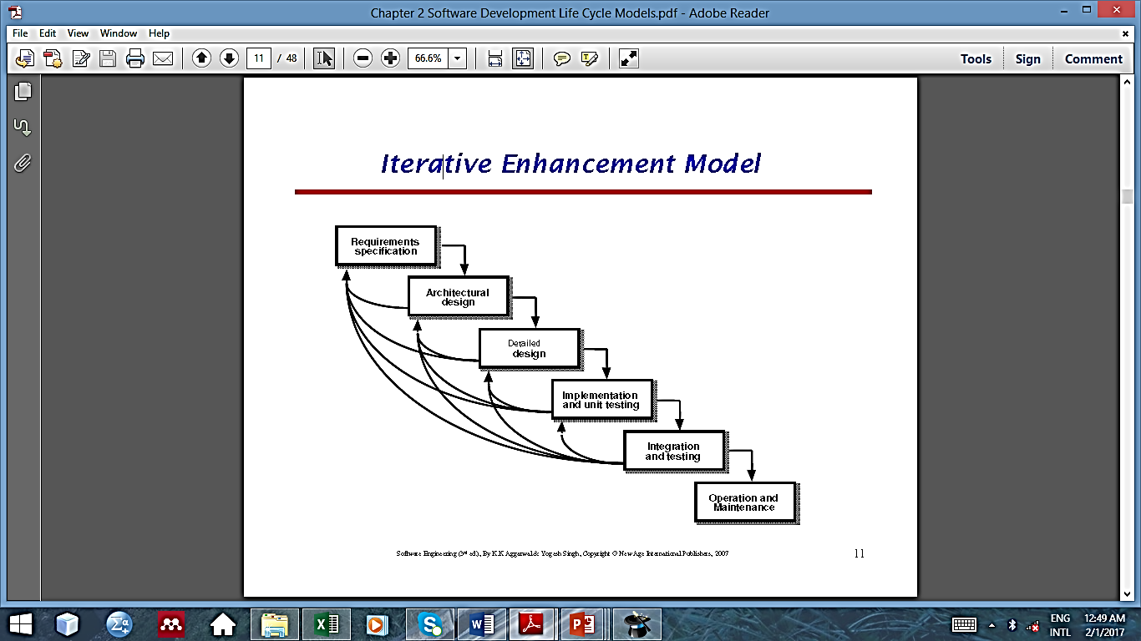
Iterative Enhancement Models
Iterative Enhancement Model
RAD Model

Slide 14
Incremental Models Problems
The process is not visible.
System structure tends to degrade as new increments are added.
Difficult problems tend to be pushed to the future to demonstrate early success to management.
Notes:
1. Managers need regular deliverables to measure progress. If systems are developed quickly, it is not cost-effective to produce documents that reflect every version of the system.
2. Unless time and money is spent on refactoring to improve the software, regular change tends to corrupt its structure. Incorporating further software changes becomes increasingly difficult and costly.

Slide 15
Reuse-oriented software engineering
Based on systematic reuse where systems are integrated from existing components or COTS (Commercial-off-the-shelf) systems.
Process stages
Component analysis;
Requirements modification;
System design with reuse;
Development and integration.
Reuse is now the standard approach for building many types of business system

Slide 16
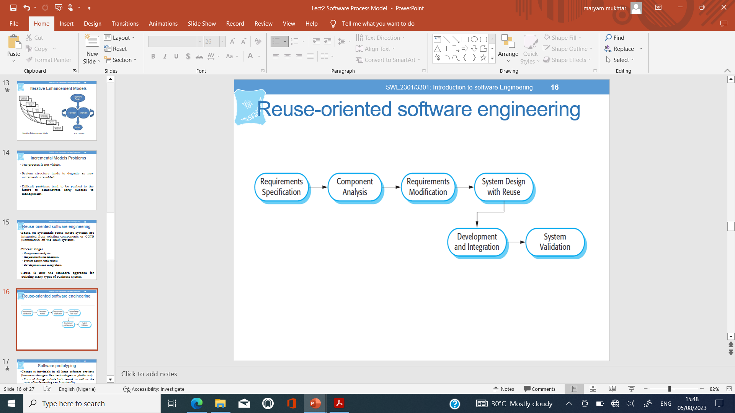
Reuse-oriented software engineering

Slide 17
Software prototyping
Change is inevitable in all large software projects (business changes, New technologies or platforms).
Costs of change include both rework as well as the costs of implementing new functionality.
Prototyping is a way of coping with change and changing system requirements
prototype is an initial version of a system used to demonstrate concepts and try out design options.
prototype can be used in requirements engineering, design or testing process.
benefits of prototyping include resolving unclear, confusing and missing requirement aa well as reducing development effort.

Slide 18
Prototyping Model

Slide 19
Prototyping Problems
Iterations add to project budgets and schedules
Designers may neglect documentation, resulting in insufficient justification for the final product and inadequate records for the future.
Can lead to poorly designed systems.

Slide 20
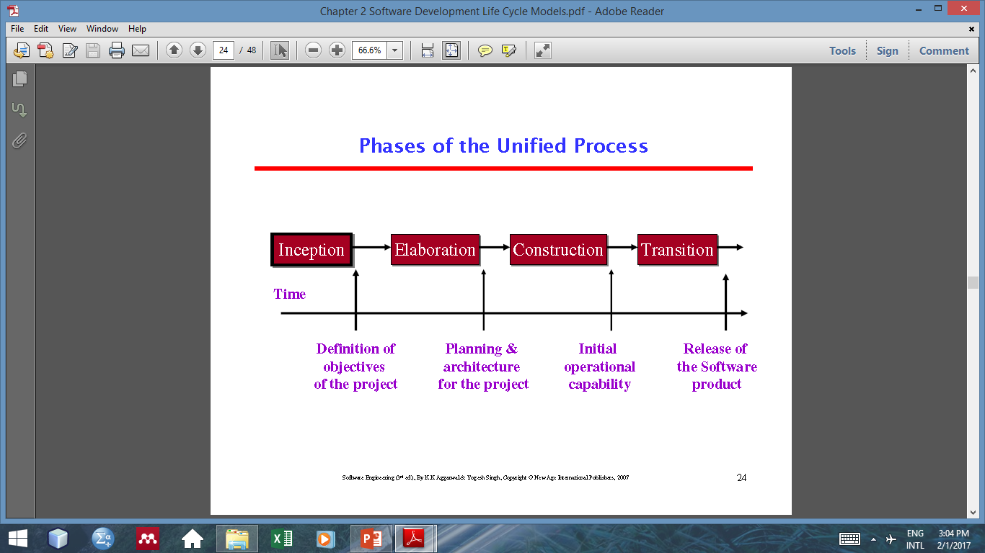
Rational Unified Process

Slide 21
Spiral Model
Emphasis is on risk analysis

Slide 22
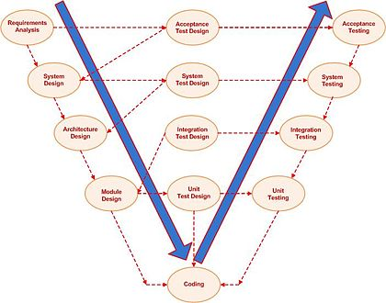
THE V-MODEL
Emphasis is Testing. The V-Model demonstrates the relationships between each phase of the development life cycle and its associated phase of testing.

Slide 23
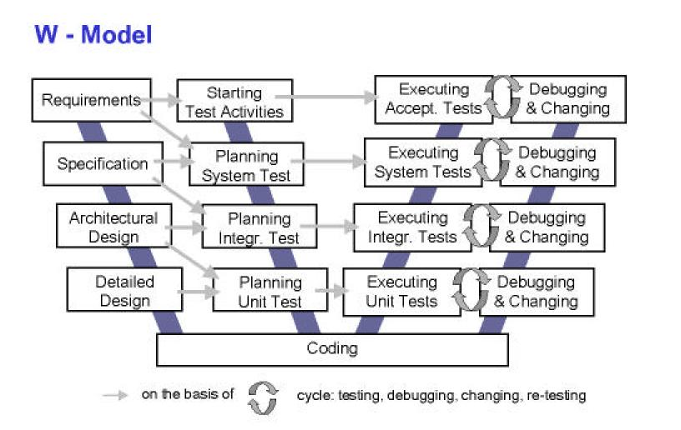
W-Model
Emphasis is Testing

Slide 24
SDLCs Wrap Up
Many different SDLCs with different phases
Four (4) fundamental activities common to all:
Software Specification (Elicitation & Analysis)
Software Design and Implementation
Software Validation (Testing)
Software Evolution (Maintenance)

Slide 25
Lecture Summary
Software process models are abstract representations of these software processes.
Changes in software development are inevitable, prototyping model can help in dealing with these changes.
Four activities are common to all SDLCs

Slide 26
Question ??

